Slide 1

Treggs Beyond your horizon!
digital
Fingers

Slide 2

Design and Process on

Slide 3
1b
Brief description
Treggs is an American global travel agency that wants to build a scalable e-commerce platform to serve a global customer base.
Main features
● Travelers can search and book travel (hotels, flights, trains, cars)
● Pricing will be individualized based on customer preferences and demand
● Strong social media integration with reviews, posts, and analytics
● Suppliers (airlines, hotels, etc.) can upload inventory
Roles of typical users
● Customer ● Traveler
● Inventory supplier ● Manager
Treggs

Slide 4
2a
User personas
Donna
Donna is a busy businesswoman who likes to take luxury weekend breaks, often booked at the last minute. A typical booking comprises a hotel and flight. Recommendations play a major role in the choice Donna makes, as does customer feedback. Donna likes to perform all operations from her phone
Treggs

Slide 5
2a
User personas
Maxwell
Maxwell is a student who likes to travel home to visit parents and also takes vacations
twice yearly. His primary concern is cost, and he will always book the lowest price travel
regardless of convenience. Maxwell has no loyalty and will use whichever retailer can
provide the best deal.
Treggs

Slide 6
2b
User stories
Search for flight and hotel
As a traveler, I want to search for a flight-hotel combination to a destination on dates of
my choice so that I can find the best price.
Treggs

Slide 7
2b
User stories
Supply hotel inventory
As a hotel operator, I want to bulk supply hotel inventory so that Treggs can sell it on my behalf.
Treggs

Slide 8
2b
User stories
Analyze sales performance
As a Treggs manager, I want to analyze the sales performance data of all our suppliers so that I can identify poor performers and help them improve.
Treggs

Slide 9
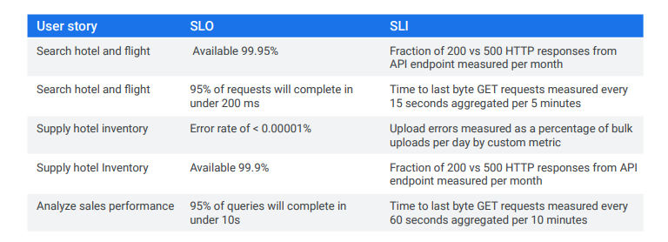
3
Defining SLIs and SLOs
Treggs

Slide 10
3
Note:
- The SLI describes what we are going to measure and how:
for example, the “Fraction of 200 vs 500 HTTP responses from API endpoint
measured per month.” This example is a way of measuring availability.
- The SLO represents the goal we are trying to achieve for a given SLI.
For example, “Available 99.95%” of the time.”
Treggs

Slide 11
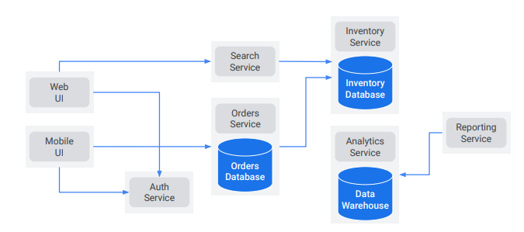
4
Microservices design for the application
Treggs

Slide 12
4
Note:
There isn’t really one and only one right way to design an application.
They are separate services for the web and mobile UIs.
There’s a shared authentication service
Microservices for search, orders, inventory, analytics and reporting.
Each of these services will be deployed as a separate application.
Where possible we want stateless services, but the orders and inventory services will need databases
The Analytics service will provide a data warehouse.
This might make a good starting point, and could be adjusted as needed when implementing the application
Treggs

Slide 13
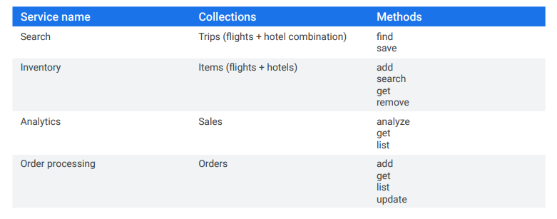
5
REST APIs design
Treggs

Slide 14
5
Note:
Obviously, our API would be larger than this, but in a way the APIs are all more of the same.
Each service manages and makes available some collection of data.
For any collection of data there are a handful of typical operations we do with that data. This is similar to Google Cloud APIs. For example in Google Cloud, there is a service called Compute Engine, which is used to create and manage virtual machines, networks, and the like. The Compute Engine API has collections like instances, instanceGroups, networks, subnetworks, and many more. For each collection, various methods are used to manage the data.
Treggs

Slide 15
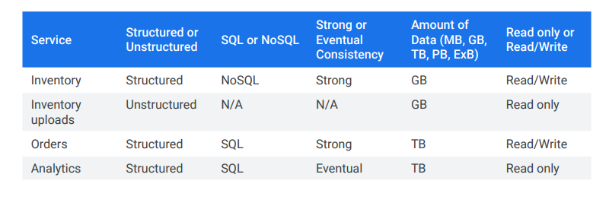
6
Storage characteristics
Each of these services has different requirements that might result in choosing different Google Cloud services.
Treggs

Slide 16
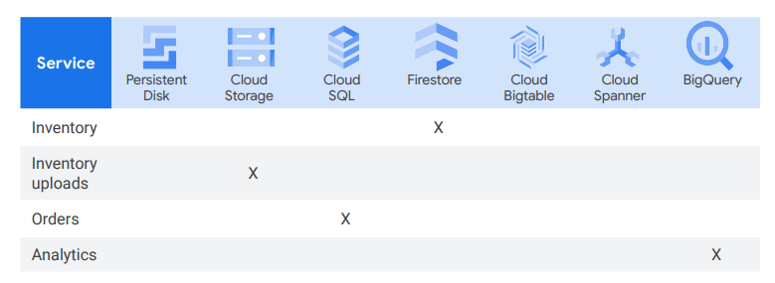
7
Google Cloud Storage and Data Services
Treggs

Slide 17
7
Note:
- For the inventory service Cloud Storage is used for the raw inventory uploads.
Suppliers will upload their inventory as JSON data stored in text files. That inventory will then be imported into a Firestore database.
The orders service will store its data in a relational database running in Cloud SQL.
The analytics service will aggregate data from various sources into a data warehouse, for which BigQuery will be used
Treggs

Slide 18
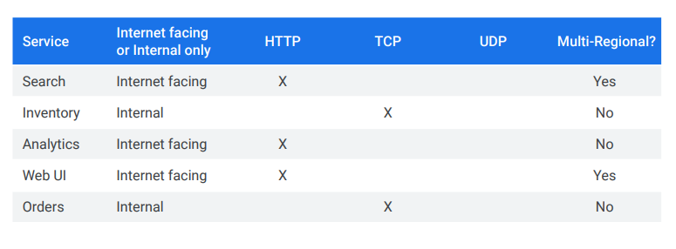
8a
Network characteristics for the services
The inventory and orders service are internal and regional using TCP. The other services need to be facing the internet using HTTP and deployed to multiple regions for lower latency, higher performance, and high availability to our users who are in multiple countries around the world
Treggs

Slide 19
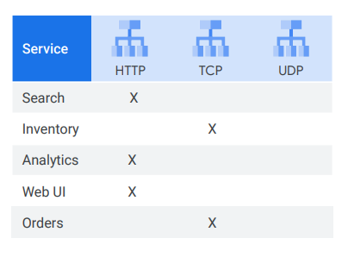
8b
load balancers for the services
Based on those network characteristics, the global HTTP load balancer was chosen for the public-facing services and the internal TCP load balancer for internal-facing services
Treggs

Slide 20
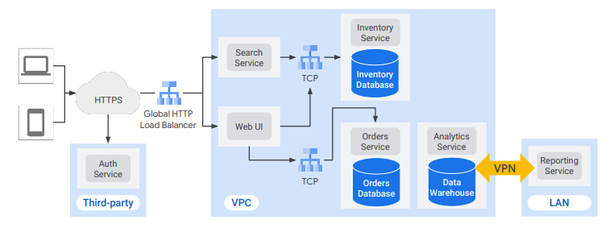
9
Network diagram
This depicts how the services will communicate over the network. Include regions, zones, load balancers, CDN, and DNS if applicable.
Treggs

Slide 21
9
Note:
- User traffic from mobile and web will first be authenticated using a third-party service.
- Then a Global HTTP Load Balancer directs traffic to our public facing Search and web UI services.
- From there, regional TCP load balancers direct traffic to the internal inventory and orders services.
- The analytics service could leverage BigQuery as the data warehouse with an on-prem reporting service that accesses the analytics service over a VPN.
This might be good enough to start, and could be refined once the implementation start
Treggs

Slide 22
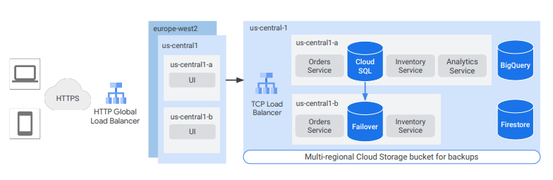
10
Designing reliable, scalable application
Even if some services are down, we want the web frontend of our application to be available nearly all the time. We also want the website to be fast with very low latency to users all over the world.
Treggs

Slide 23
10
Note:
For our online travel application, Treggs, I’m assuming that this is an American company, but have a large group of customers in Europe.
I want the UI to be highly available, so I’ve placed it into us-central1 and europe-west2 behind a global HTTP Load Balancer. This load balancer will send user requests to the region closest to the user, unless that region cannot handle the traffic.
I could also deploy the backends globally but if I’m trying to optimize cost, I could start by just deploying those in us-central1.This will create latency for our European users but I can always revisit this later and have a similar backend in europe-west2.
Treggs

Slide 24
Note:
10
To ensure high availability, I’ve decided to deploy the Orders and Inventory services to multiple zones. Because the Analytics service is not customer-facing, I can save some money by deploying it to a single zone. I again have a failover Cloud SQL database, and the Firestore database and BigQuery data warehouse are multi-regional, so I don’t need to worry about a failover for those.
The Cloud SQL database needs a failover for high availability. Because BigQuery and Firestore are managed, we don’t have to worry about that.
I’ll keep backups in a multi-regional Cloud Storage bucket in case of a disaster. That way if there is a regional outage, I can restore in another region
Treggs

Slide 25
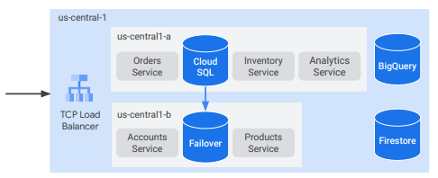
11a
Disaster recovery scenario
I've deployed for high availability by replicating resources in multiple zones. However, to meet regulatory requirements, I created a plan to bring up the application in another region if the main region is down
Treggs

Slide 26
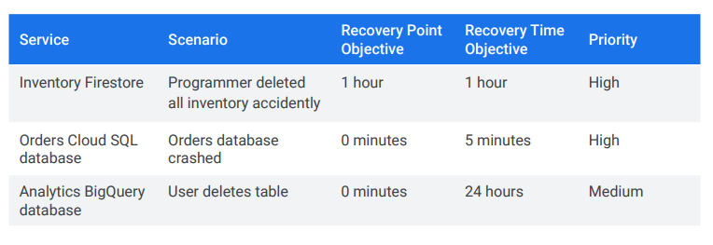
11b
Service disaster recovery scenarios
high-level list of possible scenarios. Each services uses different database services and has different objectives and priorities, all of which affects how to design the disaster recovery plans
Treggs

Slide 27
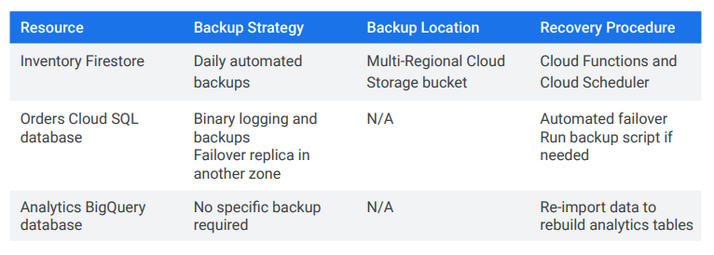
11c
Resource disaster recovery plans
Treggs

Slide 28
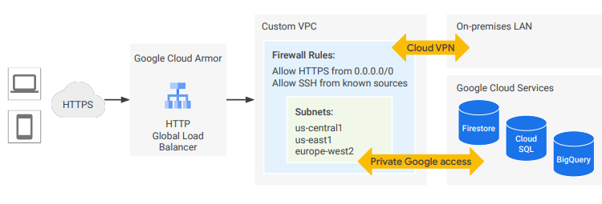
12
Secure Google Cloud services Model
Treggs

Slide 29
Note:
11c
- First, I configured Google Cloud Armor on a global HTTP Load Balancer to block any denied IP addresses.
- My custom VPC network has subnets in us-central1 for the American customers, and a backup subnet in us-east1 and a subnet in europe-west2 for the European customers.
- My firewall rules only allow SSH from known sources, and although I allow HTTPS from anywhere, I can always deny IP addresses with Google Cloud Armor at the edge of Google Cloud’s network.
- I also configured Cloud VPN tunnels to securely communicate with an
on-premises network for the reporting service.
Treggs

Slide 30
11c
Note:
Now, while the load balancer needs a public IP address, I secured the backend services by creating them without external IP addresses. In order for those instances to communicate with the Google Cloud database services, I enable Private Google Access. This enables the inventory, orders, and analytics services’ traffic to remain private, while reducing the networking costs
Treggs

Slide 31
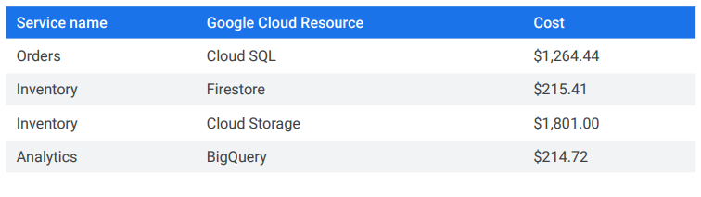
13
Cost estimating and planning
Treggs

Slide 32
11c
Note:
Here’s a rough estimate for the database applications of the online travel portal, Treggs.
I adjusted the orders database to include a failover replica for high availability and came up with some high-level estimates for the other services.
The inventory service uses Cloud Storage to store JSON data stored in text files. Because this is the most expensive service, I might want to reconsider the storage class or configure object lifecycle management.
Treggs

Slide 33
11c
Note:
Cloud SQL based on 1 instance of PostgreSQL in Iowa, 30 GB SSD storage Backup 1,000 GB, 12 cores, 16 GB RAM
Firestore based on US multi regional, 200,0000 reads per day 10000 writes 0 deletes and 1,000 GB stored
Cloud Storage Iowa - us central 50 TB storage 200,000 class A operations and 200,0000 class B operations.
BigQuery pricing based on location US multi-regional, 10 TB storage, 100 GB per month streaming, 2 TB queries
Treggs

Slide 34
digital
Fingers
“Customer centric and reliable infrastructure design”.
THANK YOU

